Slide 1

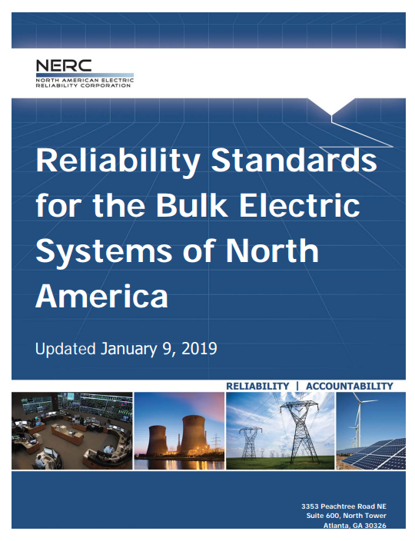
Fundamentals of Electric Transmission System Planning Short Course
The Role of Regional Planning Organizations
Tracy Rolstad

Slide 2
Remember This Slide!
What is your job ultimately?
To be boring!
Regional Planning is all about this
Plus, FERC sad we weren’t very good at it…
They were right by the way
So, they fired out a NOPR flowed by an Order
What is an NOPR?

Slide 3
Regional Planning Works Because?
What is your job ultimately?
To be boring!
Defeat the “enemy”
Who is the enemy?
Poor or unreliable service (outages)
We provide a commodity (electricity)
Virtually indistinguishable from “competitors”
Except for price
Be safe, reliable, affordable…
If you know the enemy and you know yourself, your victory will not stand in doubt ~ Sun Tzu

Slide 4

The 40-Year Fallout
1977 Outage
1996 Outage
2003 Outage
New York City blackout occurs
Leads to first limited reliability provision in Fed. Govt.
Enables Govt. to propose voluntary standards
Two major blackouts in Western U.S.
WSCC develops Reliability Standards System
Member utilities voluntarily agree to pay fines to WSCC for reliability Violations
Still no Federal Regulation
Worst blackout to date in U.S. occurs
Task force is put together to investigate outage
Final report concludes that to prevent future blackouts, govt. need's mandatory reliability standards.
You had your chance!
Notes:
Western Systems Coordinating Council

Slide 5
Mandatory Reliability Standards
2006 – NERC Files an application with FERC to become ERO in U.S.
2007 – NERC has been certified by FERC and reliability standards become mandatory for all Utilities
Now NERC Standards are a cottage industry made from nothing!
Version 0 Reliability Standards
In 2004, NERC begins translating it’s operating policies in to 90 measurable standards
Energy Policy Act of 2005
Authorizes the creation of a Electric Reliability Organization w/ oversight from NERC

Slide 6
Some more Notable FERC Events
1965
Formation of NERC and Coordinating Councils
They were supposed to do regional planning
I would say they failed
1999
Order 2000
Facilitates RTO Formation
2010
Order 1000
Right…Order 1000 came after Order 2000
Truly FERC’s naming convention is unknowable
Order 1000 reforms Order 890
Remember 890? Feb 2007

Slide 7
FERC Order 890
Among other things it was trying to:
Require transmission providers to participate in a coordinated, open and transparent planning process on both local and regional levels. A description of the planning process must be included in the OATT.
It was found to be lacking…hence Order 1000.

Slide 8
FERC Order 1000
Planning Reforms The rule establishes three requirements for transmission planning:
Each public utility transmission provider must participate in a regional transmission planning process that satisfies the transmission planning principles of Order No. 890 and produces a regional transmission plan.
Local and regional transmission planning processes must consider transmission needs driven by public policy requirements established by state or federal laws or regulations. Each public utility transmission provider must establish procedures to identify transmission needs driven by public policy requirements and evaluate proposed solutions to those transmission needs.
Public utility transmission providers in each pair of neighboring transmission planning regions must coordinate to determine if there are more efficient or cost-effective solutions to their mutual transmission needs.
https://www.ferc.gov/industries/electric/indus-act/trans-plan.asp

Slide 9
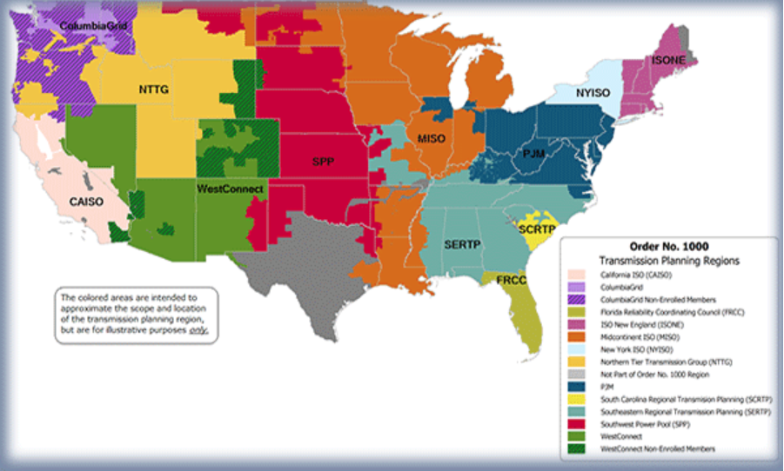
Visual of the Outcomes (circa 2018)

Slide 10
Regional Planning Organizations
What do they do?
Intra-regional planning
Cost allocation environment
”Long staple” through members plans
They are independent Planners so if they see an issue they will pursue a solution through their respective agreements
Case building generally happens here
Provide another forum for public transparency
Perform Production Cost modeling work regionally
ISO/RTO markets don’t have RPO’s
They ARE an RPO

Slide 11
Where you won’t hear about RPO’s
Unless you broaden your view
Look past Order 1000
NERC serves a role
And RPO’s care about→
The “balkanized” West
CAISO is a well-oiled machine
The Northwest is a mess
BPA has federal law that limits their ability to play in an ISO/RTO
This mess is 20 years old
Have I mentioned inverse dog years?

Slide 12
Columbia Grid (replaced by NorthernGrid)
Outstanding staff and work (deep experience)
Oddly, only Avista and Puget must belong
Everyone else is NOT FERC jurisdictional
Do you know what that means?
Outcomes
Area coordination (open & transparent)
Transparency to the public at large
Open meetings…very useful
Studies and workshops
PNW non-wires meeting for example
Provides messaging to state capitals
Peer groups that function better than at WECC

Slide 13
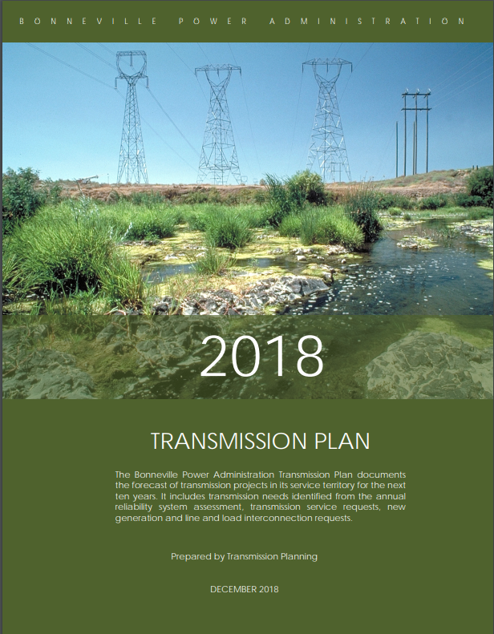
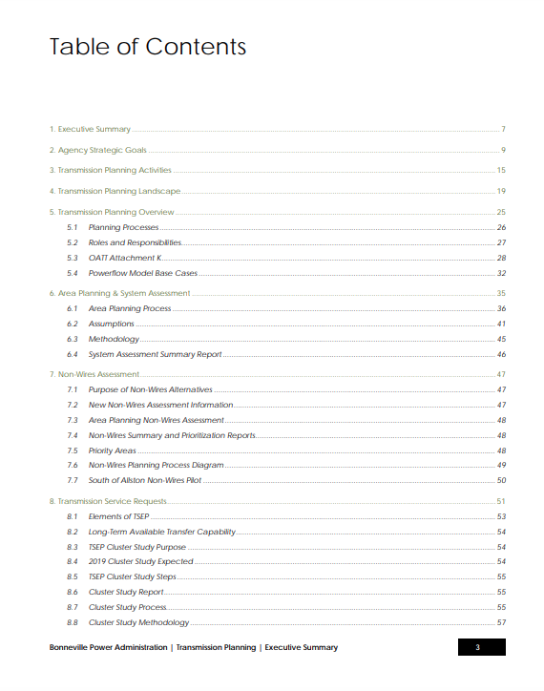
Might Not Be Available Except for CG
https://www.bpa.gov/transmission/CustomerInvolvement/AttachmentK/Documents/2018-BPA-Transmission-Plan-Final.pdf

Slide 14
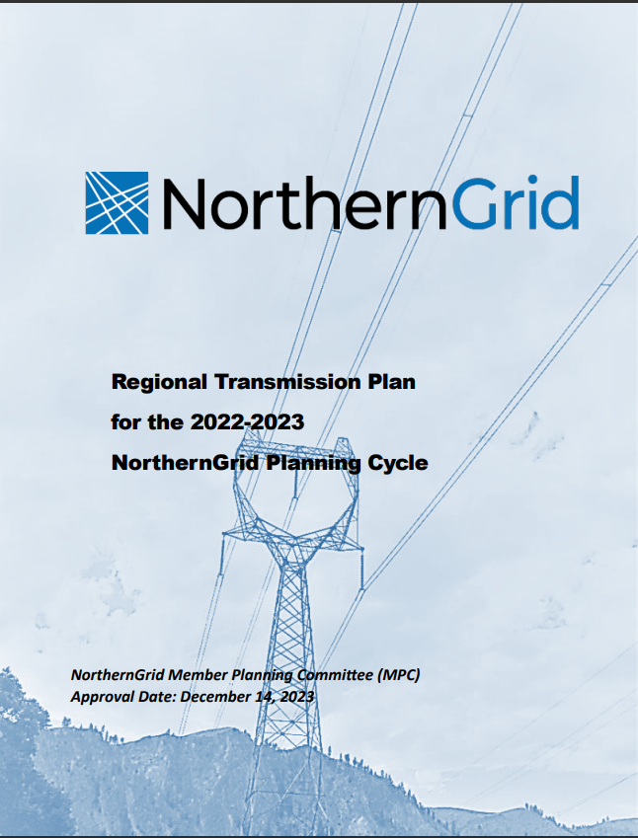
NorthernGrid Plans
https://www.northerngrid.net/private-media/documents/2022-23_Regional_Transmission_Plan.pdf

Slide 15
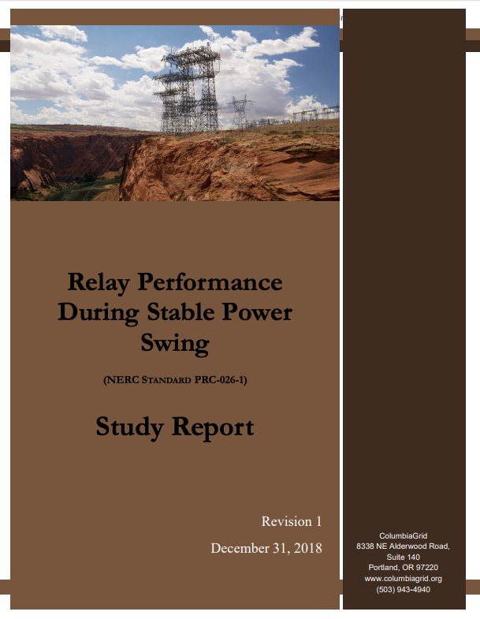
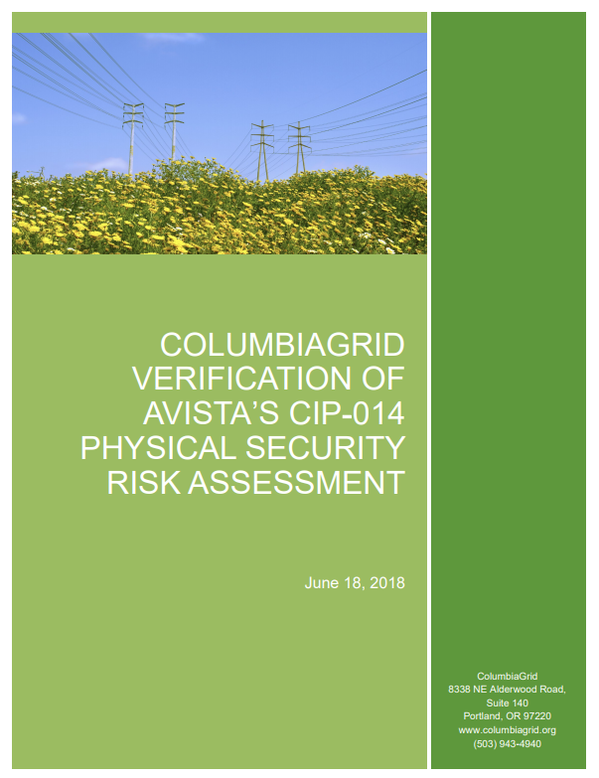
Example RPO Work Products (=2 FTE)
Compliance
Note that NorthernGrid
performs a notably
different role than did
ColumbiaGrid.
Focus is on Production Cost
Modeling.
RPO’s can and will come and
go. Organizational change
happens…

Slide 16
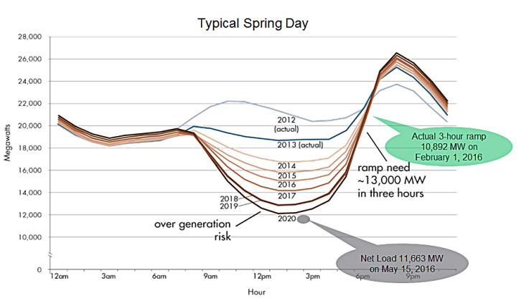
CAISO
The Duck Curve
It was an RPO thing first…openness is good!

Slide 17
Compliance and the RPO
RPO’s help us comply with NERC Standards
MOD-033, PRC-026, TPL-007
Done by our RPO
MOD-033 is so well done non-members use it
RPO’s provide communication we needed
We NEVER communicated this well
See “duck curve” slide
We learn from each other
Utilities really don’t compete with each other
Only down side is the cost

Slide 18
Example RPO’s (some are ISO’s)
CAISO
www.caiso.com
ERCOT
http://www.ercot.com/
WestConnect
http://www.westconnect.com/
AESO
www.aeso.ca
Goldmines of professionally relevant
educational and practical documentation.
If you are subject to an ISO/RTO you HAVE
to follow their rules. Still planning like a
warrior? Know your “enemy.”

Slide 19
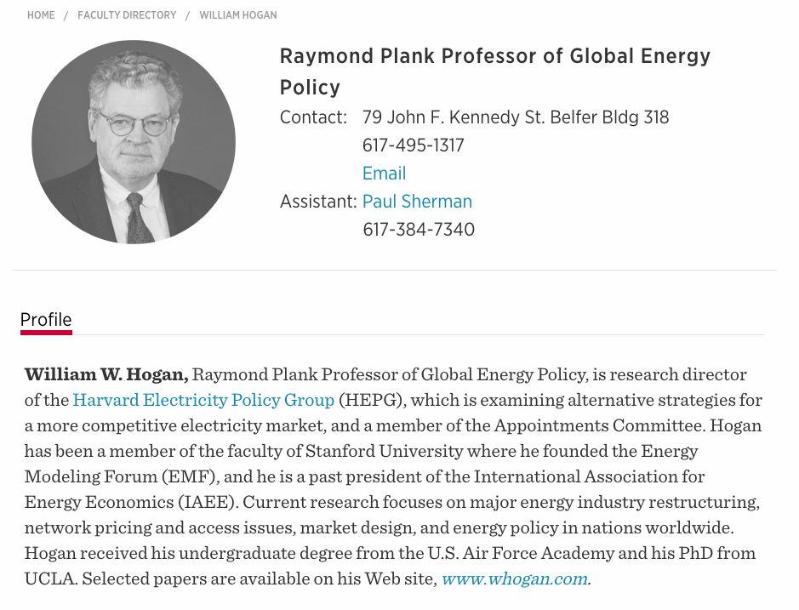
Economist Influencers
One of the influencers around electricity markets
And thus ISO/RTO/RPO, etc.
Not sure that RTO’s and ISO’s lower costs

Slide 20
Take Away’s
Planning is NOT just Electrical Engineering’
Honestly, the engineering is the easy part
Everyone seems to have opinion!
Utility Planners need to be engaged

Slide 21

Questions?

